Slide 1
파이썬 OpenCV 영상처리 실습 1, 2
경남대학교
3/7 ~ 3/8
배명진(Bae Myung Jin)

Slide 2
7 ~ 8일차
파이썬 OpenCV 영상처리 실습

Slide 3
Tkinter + OpenCV
import cv2
import tkinter
from PIL import Image
from PIL import ImageTk
def convert_to_tkimage():
global src
gray = cv2.cvtColor(src, cv2.COLOR_BGR2GRAY)
_, binary = cv2.threshold(gray, 100, 255, cv2.THRESH_BINARY)
img = Image.fromarray(binary)
imgtk = ImageTk.PhotoImage(image=img)
label.config(image=imgtk)
label.image = imgtk
window=tkinter.Tk()
window.title("YUN DAE HEE")
window.geometry("640x480+100+100")
src = cv2.imread("giraffe.jpg")
src = cv2.resize(src, (640, 400))
img = cv2.cvtColor(src, cv2.COLOR_BGR2RGB)
img = Image.fromarray(img)
imgtk = ImageTk.PhotoImage(image=img)
label = tkinter.Label(window, image=imgtk)
label.pack(side="top")
button = tkinter.Button(window, text="이진화 처리", command=convert_to_tkimage)
button.pack(side="bottom", expand=True, fill='both')
window.mainloop()

Slide 4
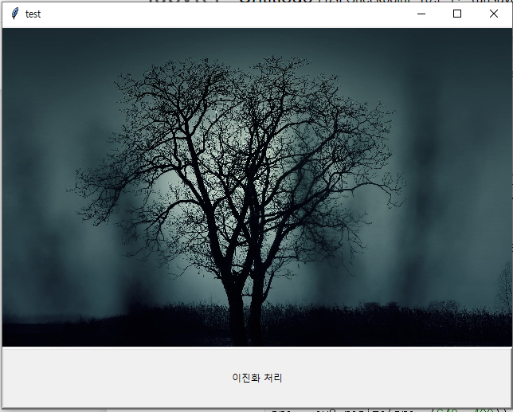
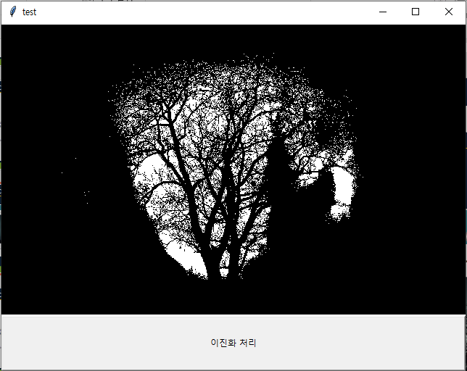
Tkinter + OpenCV
ː ː 원본 이미지
ː ː 실행 결과

Slide 5
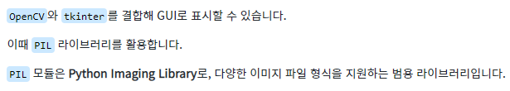
Tkinter + OpenCV
import cv2
import tkinter
from PIL import Image
from PIL import ImageTk
def convert_to_tkimage():
global src
gray = cv2.cvtColor(src, cv2.COLOR_BGR2GRAY)
_, binary = cv2.threshold(gray, 100, 255, cv2.THRESH_BINARY)
img = Image.fromarray(binary)
imgtk = ImageTk.PhotoImage(image=img)
label.config(image=imgtk)
label.image = imgtk
window=tkinter.Tk()
window.title("test")
window.geometry("640x480+100+100")
src = cv2.imread("tree.jpg")
src = cv2.resize(src, (640, 400))
img = cv2.cvtColor(src, cv2.COLOR_BGR2RGB)
img = Image.fromarray(img)
imgtk = ImageTk.PhotoImage(image=img, master=window)
label = tkinter.Label(window, image=imgtk)
label.image = imgtk
label.pack(side="top")
button = tkinter.Button(window, text="이진화 처리", command=convert_to_tkimage)
button.pack(side="bottom", expand=True, fill='both')
window.mainloop()

Slide 6
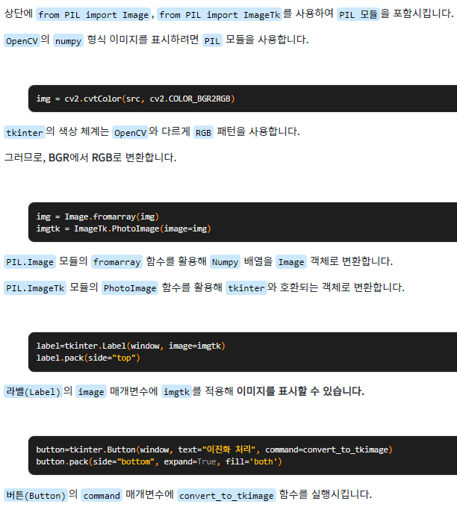
Tkinter + OpenCV
window=tkinter.Tk()
window.title("YUN DAE HEE")
window.geometry("640x480+100+100")
src = cv2.imread("giraffe.jpg")
src = cv2.resize(src, (640, 400))
img = cv2.cvtColor(src, cv2.COLOR_BGR2RGB)
img = Image.fromarray(img)
imgtk = ImageTk.PhotoImage(image=img)
label = tkinter.Label(window, image=imgtk)
label.pack(side="top")
button = tkinter.Button(window, text="이진화 처리", command=convert_to_tkimage)
button.pack(side="bottom", expand=True, fill='both')
window.mainloop()

Slide 7
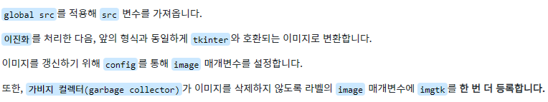
Tkinter + OpenCV
import cv2
import tkinter
from PIL import Image
from PIL import ImageTk
def convert_to_tkimage():
global src
gray = cv2.cvtColor(src, cv2.COLOR_BGR2GRAY)
_, binary = cv2.threshold(gray, 100, 255, cv2.THRESH_BINARY)
img = Image.fromarray(binary)
imgtk = ImageTk.PhotoImage(image=img)
label.config(image=imgtk)
label.image = imgtk

Slide 8
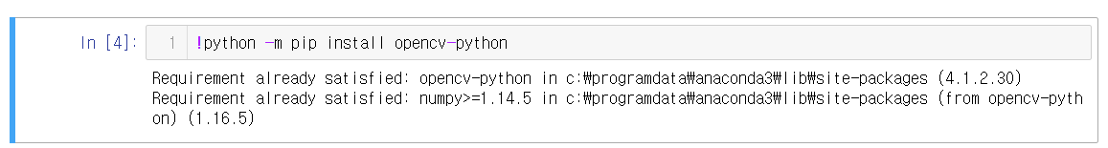
OpenCV 설치
ː ː 실행 결과

Slide 9
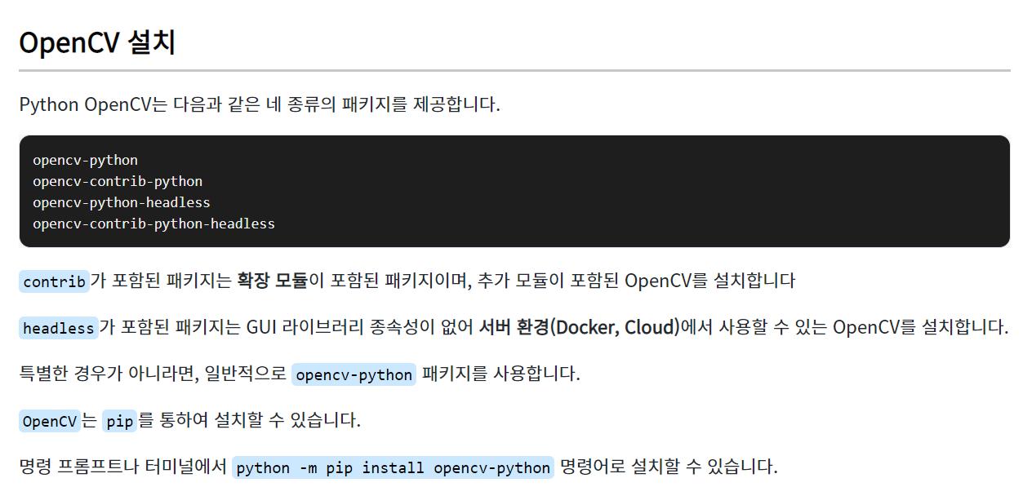
OpenCV 설치
!python -m pip install opencv-python

Slide 10
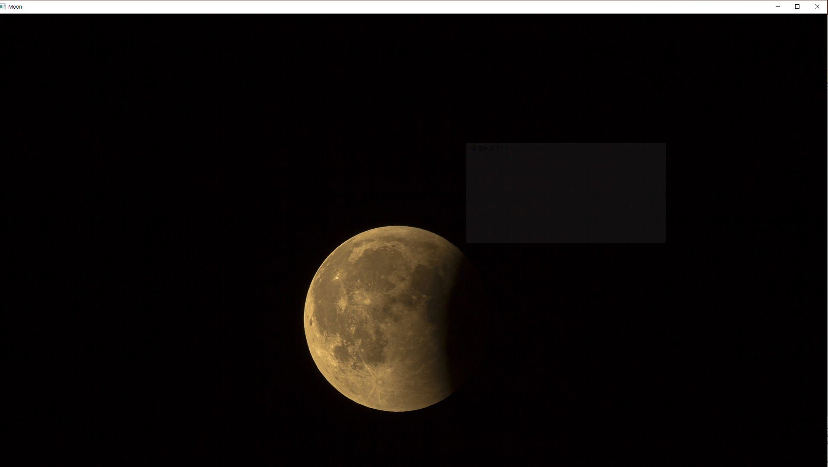
이미지 불러오기
ː ː 실행 결과

Slide 11
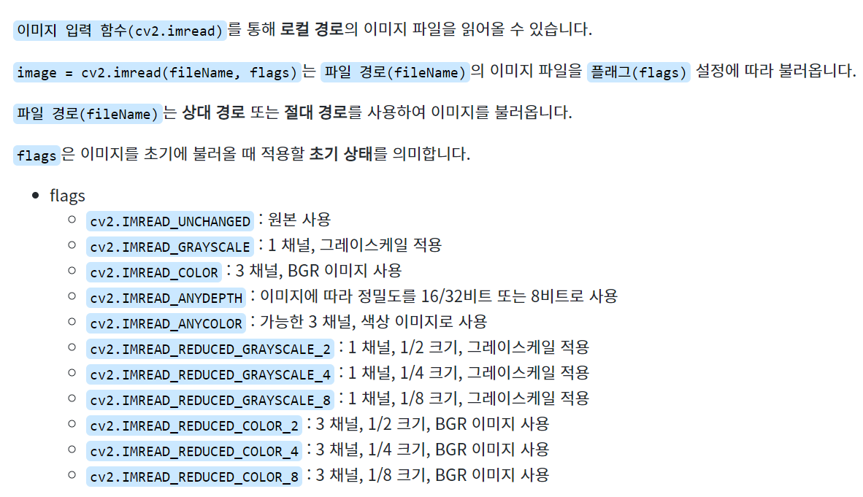
이미지 불러오기
import cv2
image = cv2.imread(“image/lunar.jpg", cv2.IMREAD_ANYCOLOR)
cv2.imshow("Moon", image)
cv2.waitKey()
cv2.destroyAllWindows()

Slide 12
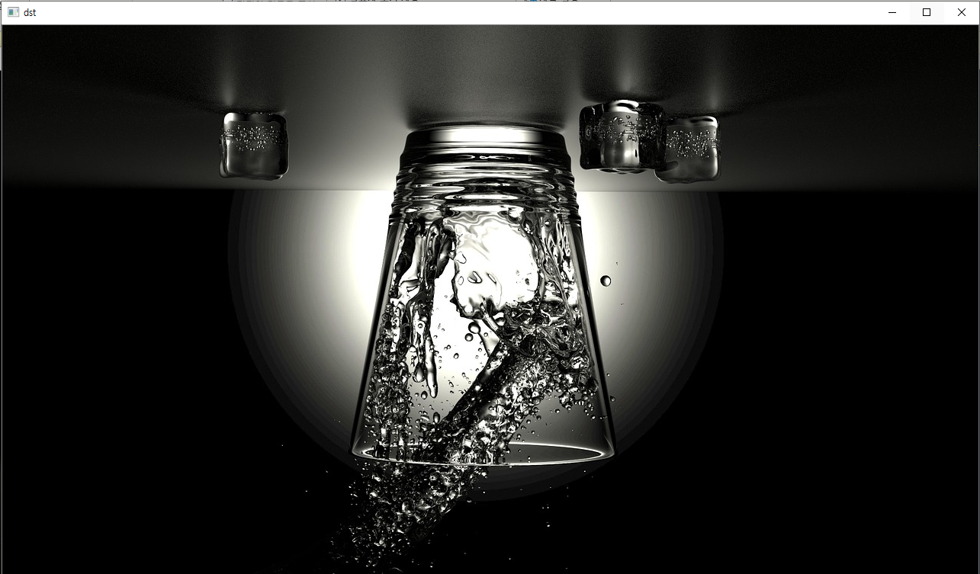
대칭 (Flip, Symmetry)
ː ː 실행 결과

Slide 13
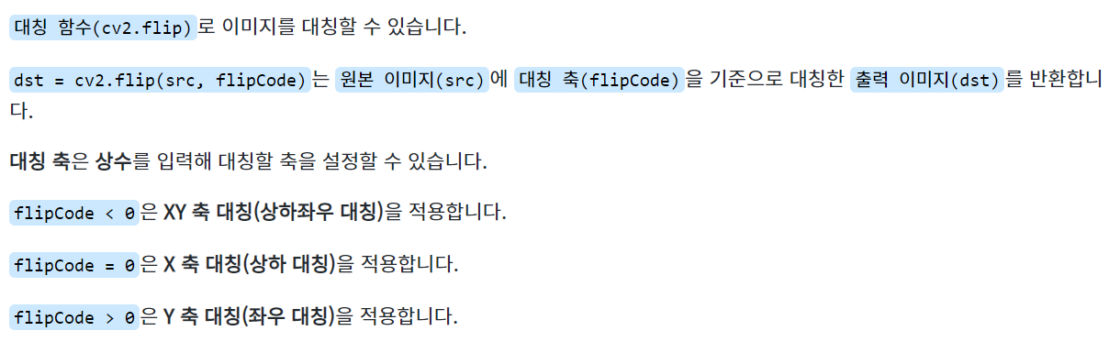
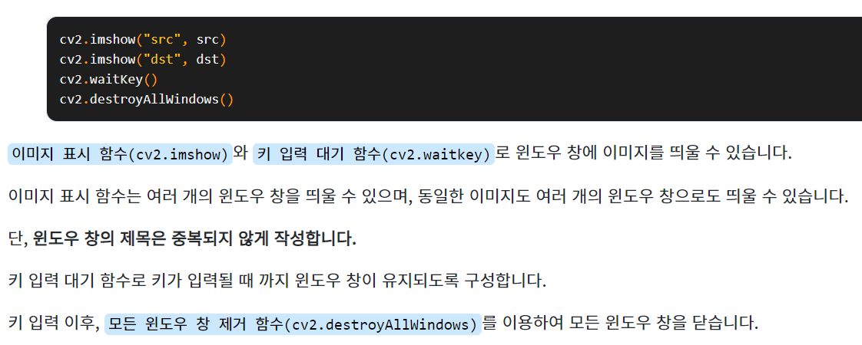
대칭 (Flip, Symmetry)
import cv2
src = cv2.imread("Image/glass.jpg", cv2.IMREAD_COLOR)
dst = cv2.flip(src, 0)
cv2.imshow("src", src)
cv2.imshow("dst", dst)
cv2.waitKey()
cv2.destroyAllWindows()

Slide 14
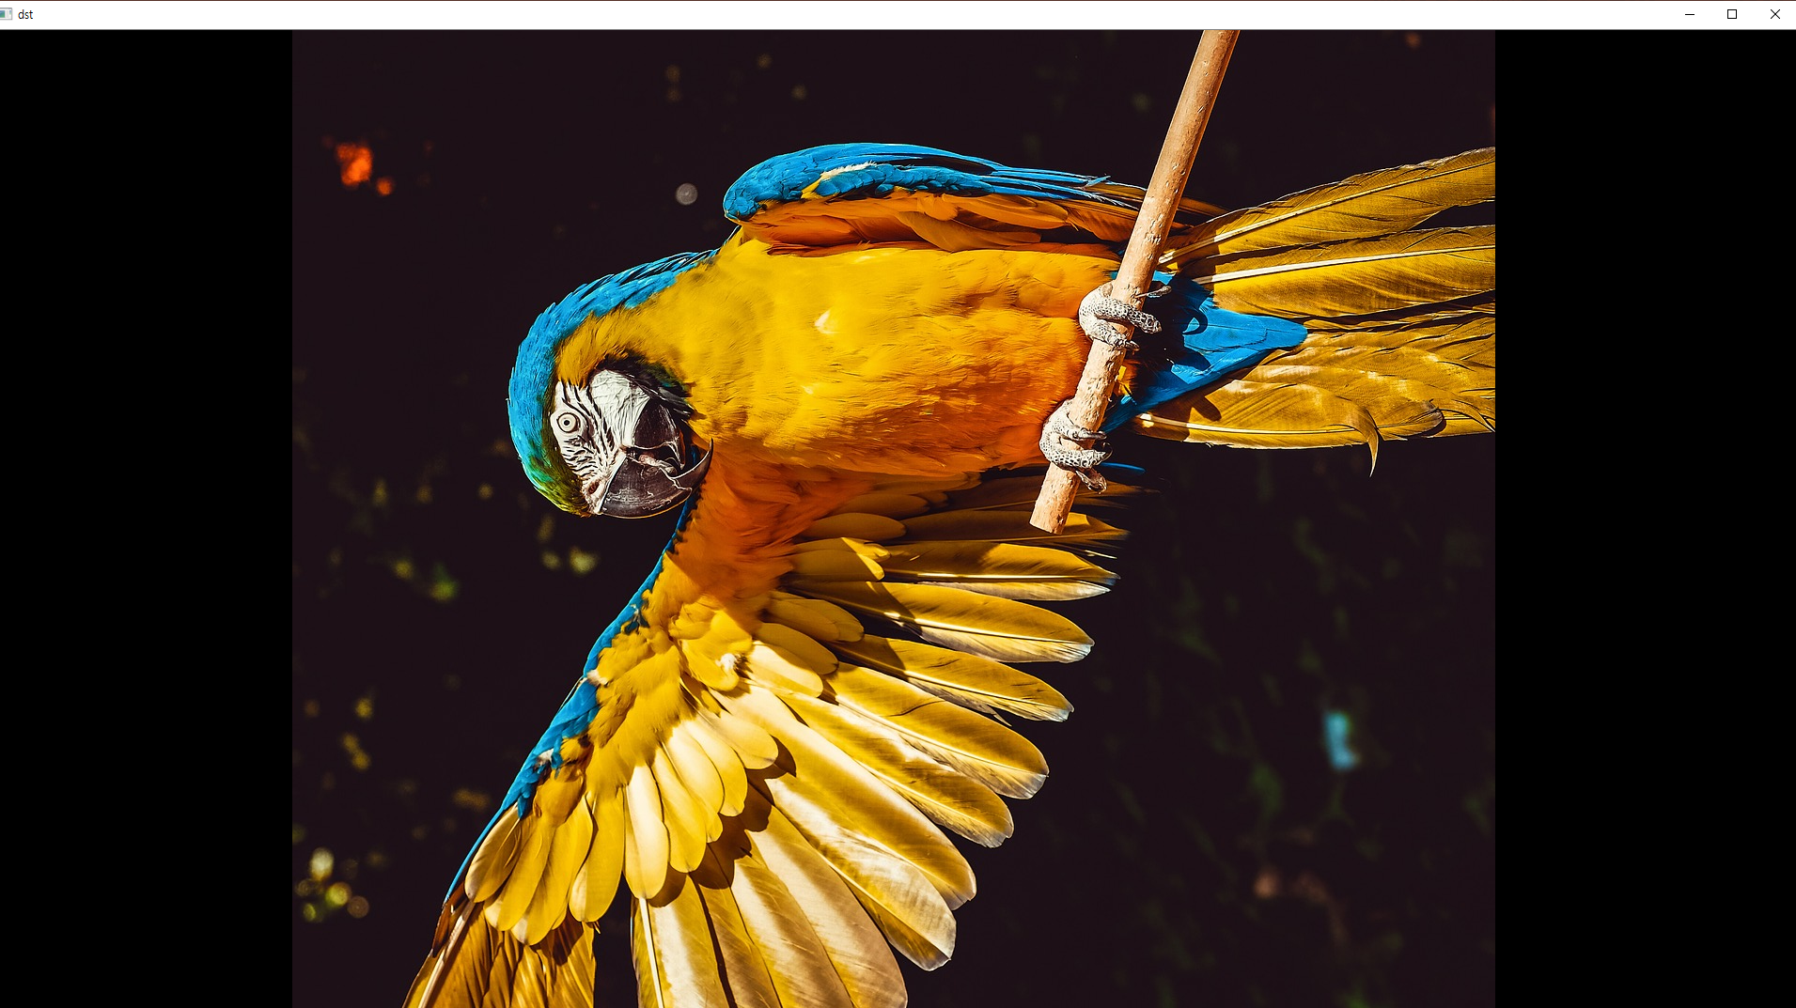
회전 (Rotate)
ː ː 실행 결과

Slide 15
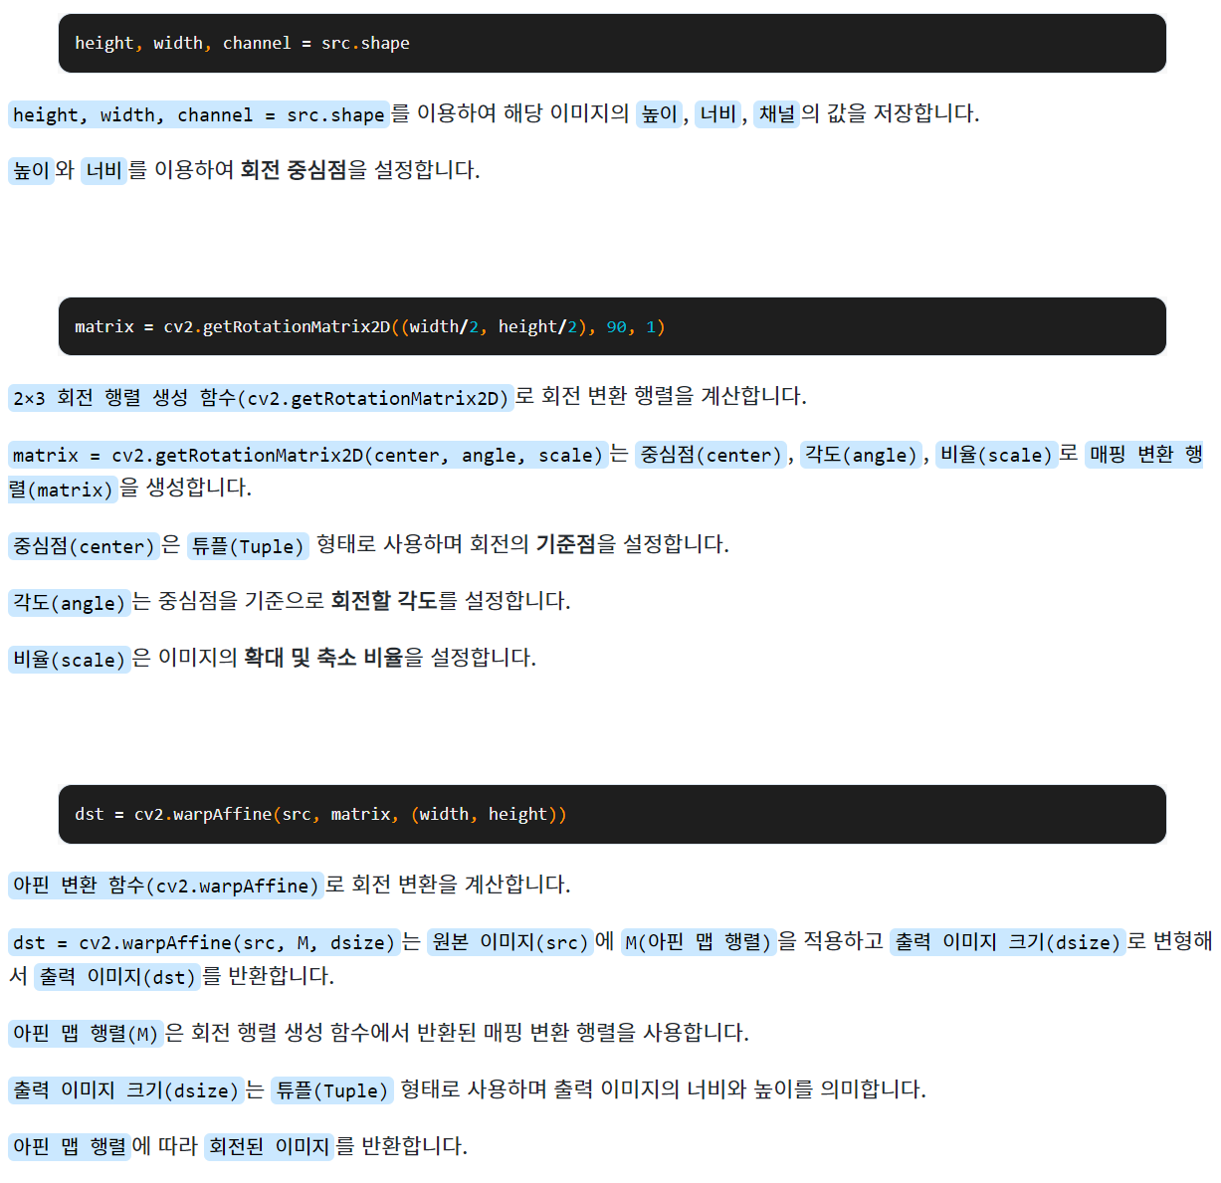
회전 (Rotate)
import cv2
src = cv2.imread("Image/ara.jpg", cv2.IMREAD_COLOR)
height, width, channel = src.shape
matrix = cv2.getRotationMatrix2D((width/2, height/2), 90, 1)
dst = cv2.warpAffine(src, matrix, (width, height))
cv2.imshow("src", src)
cv2.imshow("dst", dst)
cv2.waitKey()
cv2.destroyAllWindows()

Slide 16
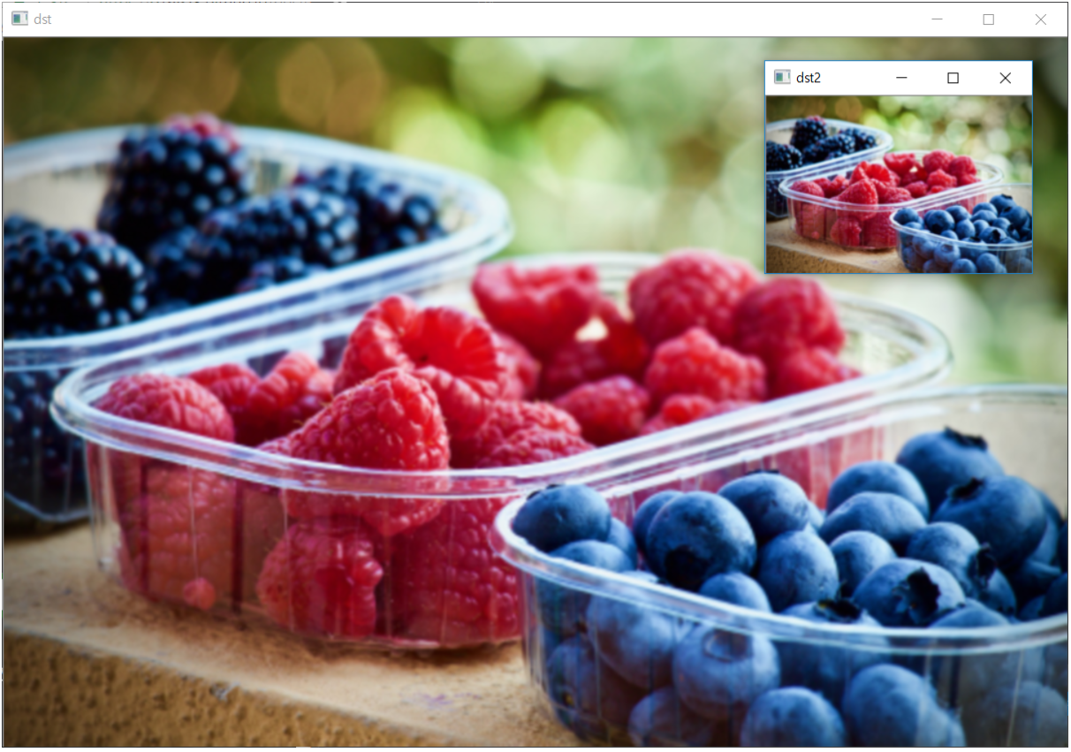
이미지 피라미드(Image Pyramid)
ː ː 실행 결과

Slide 17
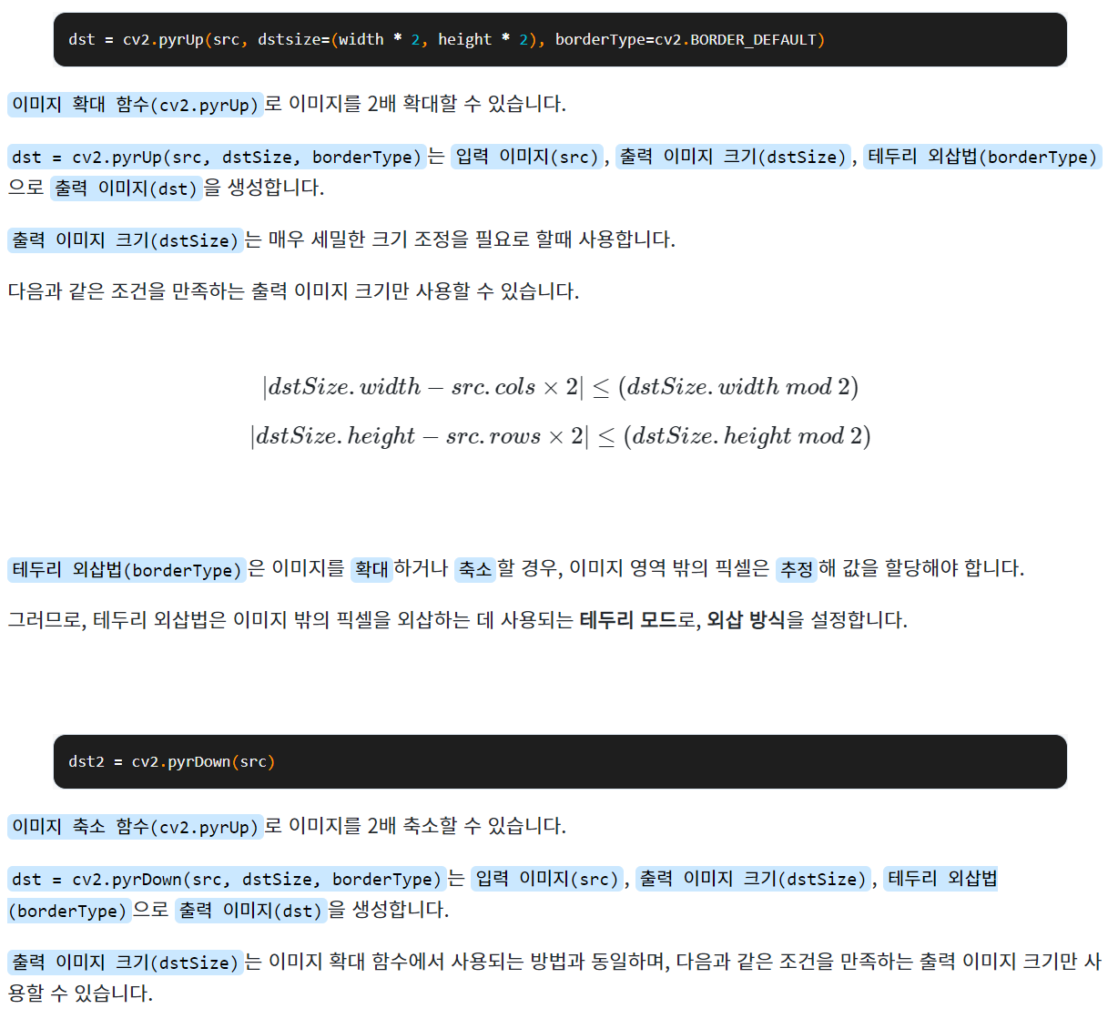
이미지 피라미드(Image Pyramid)
import cv2
src = cv2.imread("Image/fruits.jpg", cv2.IMREAD_COLOR)
height, width, channel = src.shape
dst = cv2.pyrUp(src, dstsize=(width * 2, height * 2), borderType=cv2.BORDER_DEFAULT)
dst2 = cv2.pyrDown(src)
cv2.imshow("src", src)
cv2.imshow("dst", dst)
cv2.imshow("dst2", dst2)
cv2.waitKey()
cv2.destroyAllWindows()

Slide 18
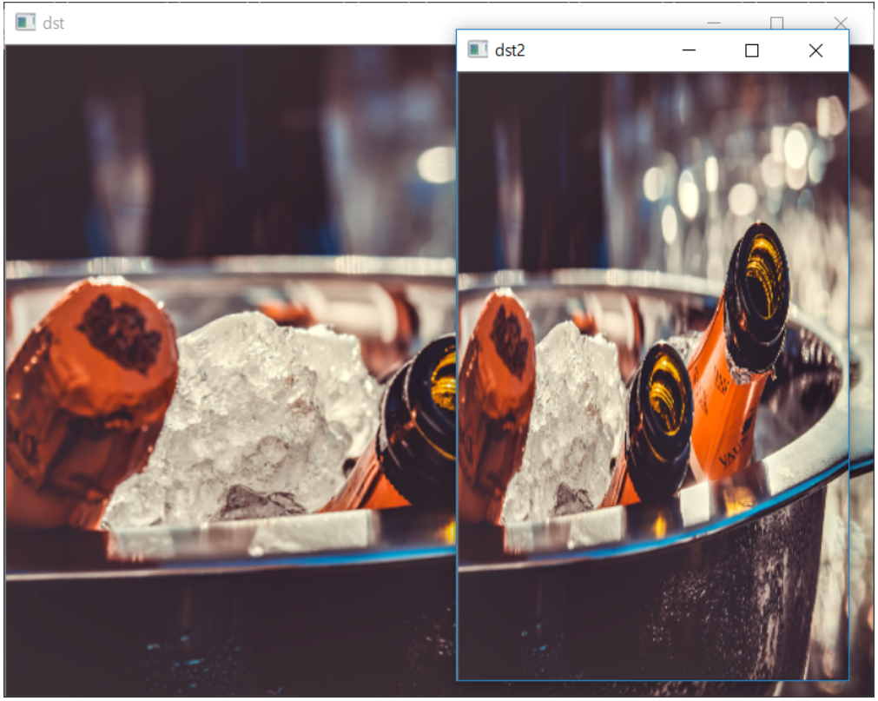
크기 조절(Resize)
ː ː 실행 결과

Slide 19
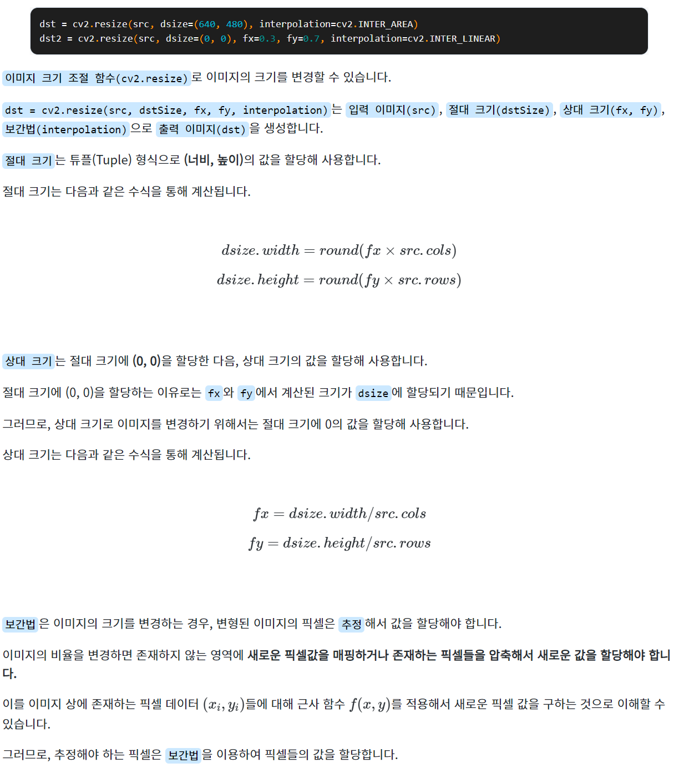
크기 조절(Resize)
import cv2
src = cv2.imread("Image/champagne.jpg", cv2.IMREAD_COLOR)
dst = cv2.resize(src, dsize=(640, 480), interpolation=cv2.INTER_AREA)
dst2 = cv2.resize(src, dsize=(0, 0), fx=0.3, fy=0.7, interpolation=cv2.INTER_LINEAR)
cv2.imshow("src", src)
cv2.imshow("dst", dst)
cv2.imshow("dst2", dst2)
cv2.waitKey()
cv2.destroyAllWindows()

Slide 20
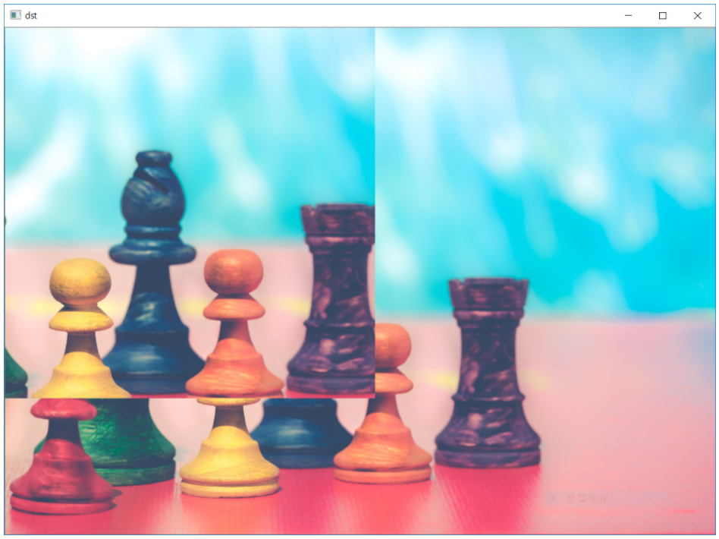
자르기(Slice)
ː ː 실행 결과

Slide 21
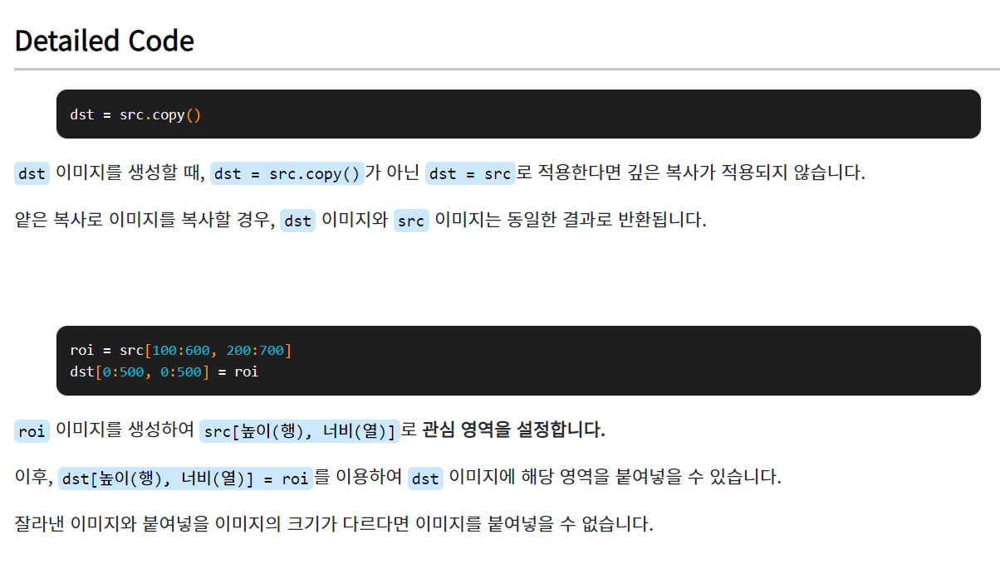
자르기(Slice)
import cv2
src = cv2.imread("apple.jpg", cv2.IMREAD_COLOR)
dst = src[100:600, 200:700].copy()
cv2.imshow("src", src)
cv2.imshow("dst", dst)
cv2.waitKey()
cv2.destroyAllWindows()
import cv2
src = cv2.imread("Image/pawns.jpg", cv2.IMREAD_COLOR)
dst = src.copy()
roi = src[100:600, 200:700]
dst[0:500, 0:500] = roi
cv2.imshow("src", src)
cv2.imshow("dst", dst)
cv2.waitKey()
cv2.destroyAllWindows()

Slide 22
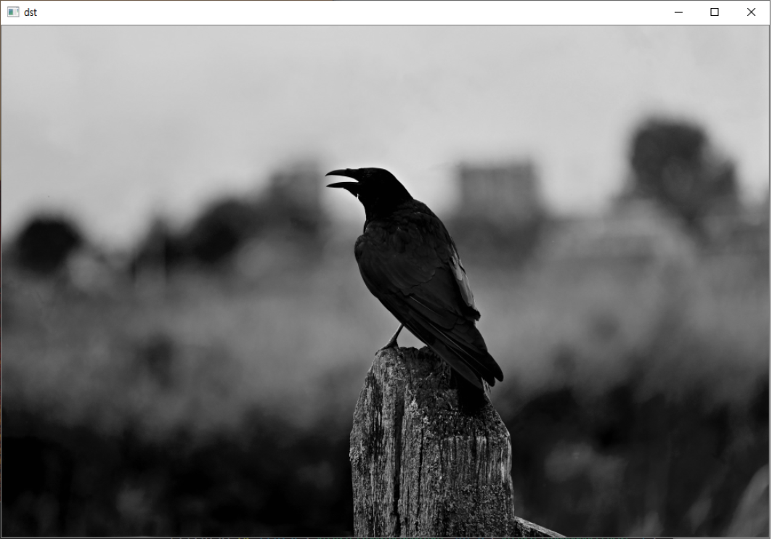
색상 공간 변환(Convert Color)
ː ː 실행 결과

Slide 23
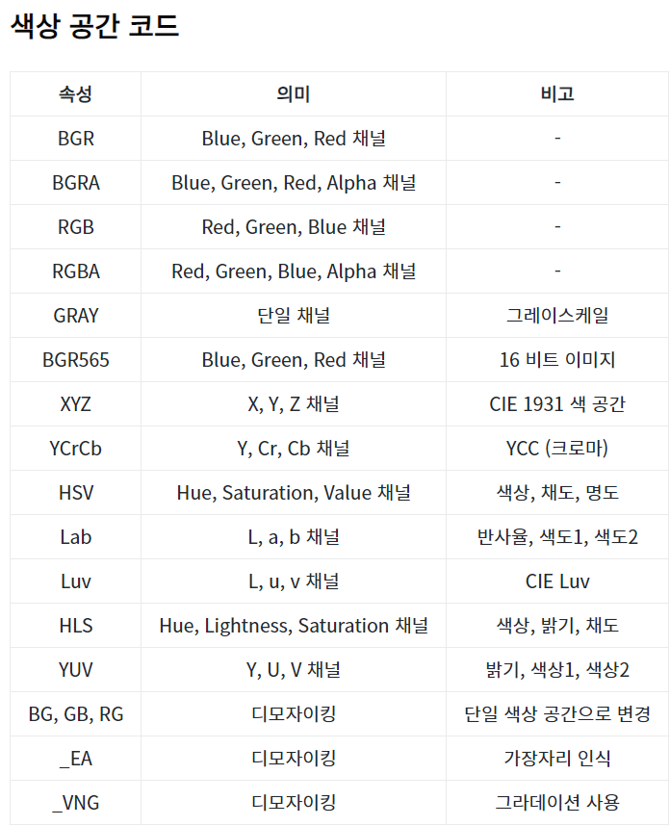
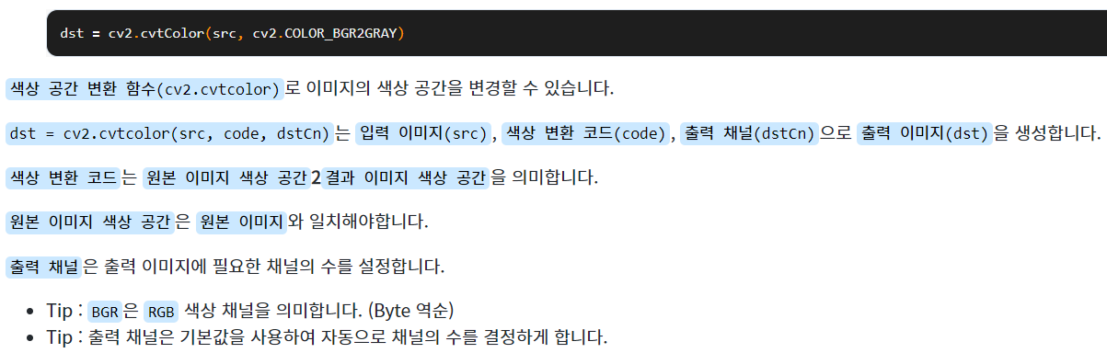
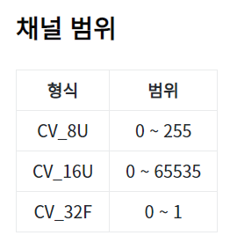
색상 공간 변환(Convert Color)
import cv2
src = cv2.imread("Image/crow.jpg", cv2.IMREAD_COLOR)
dst = cv2.cvtColor(src, cv2.COLOR_BGR2GRAY)
cv2.imshow("src", src)
cv2.imshow("dst", dst)
cv2.waitKey()
cv2.destroyAllWindows()

Slide 24
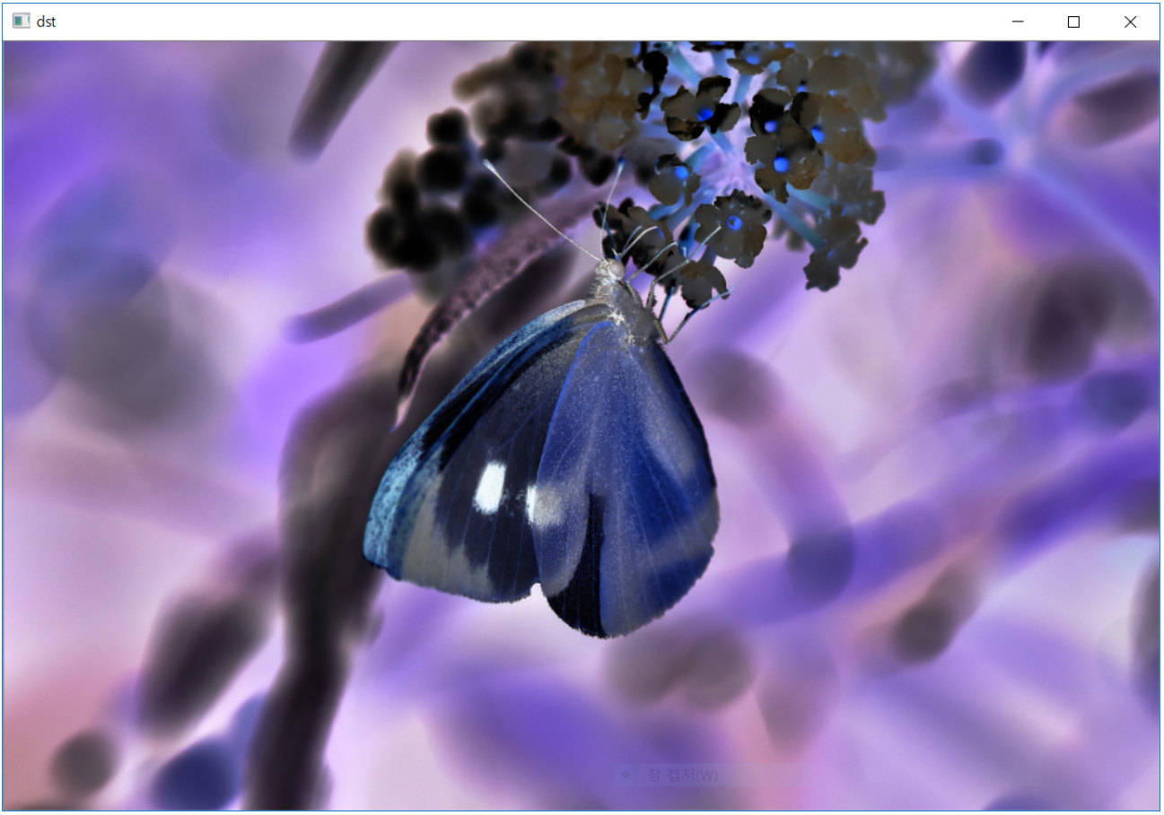
역상(Reverse Image)
ː ː 실행 결과

Slide 25
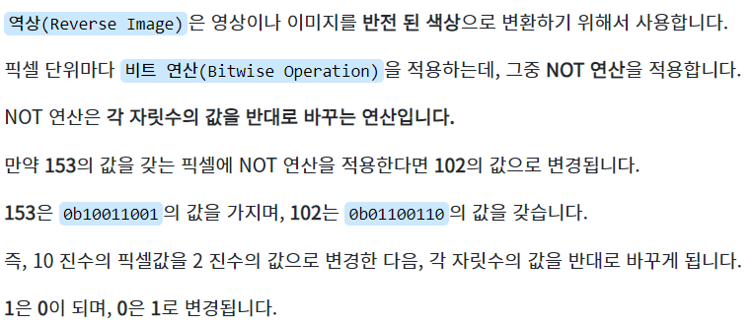
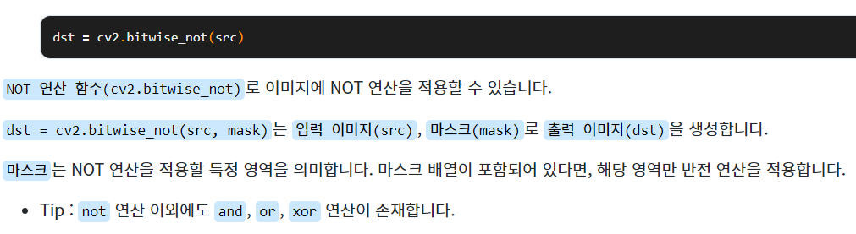
역상(Reverse Image)
import cv2
src = cv2.imread("Image/whitebutterfly.jpg", cv2.IMREAD_COLOR)
dst = cv2.bitwise_not(src)
cv2.imshow("src", src)
cv2.imshow("dst", dst)
cv2.waitKey()
cv2.destroyAllWindows()

Slide 26
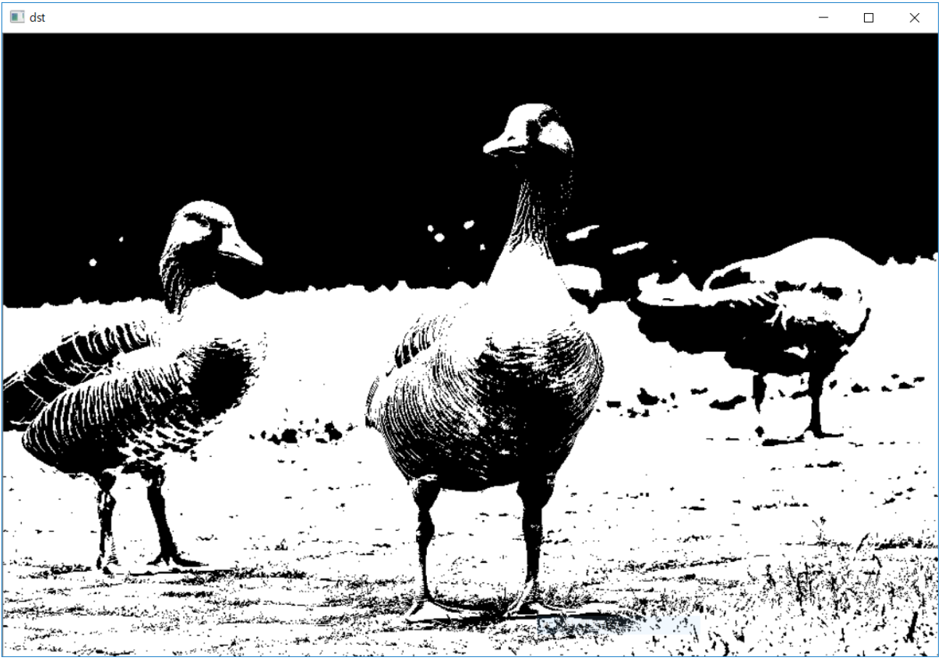
이진화(Binary)
ː ː 실행 결과

Slide 27
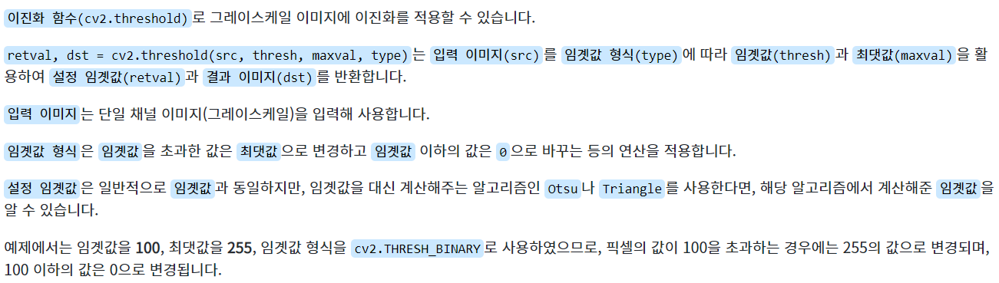
이진화(Binary)
import cv2
src = cv2.imread("Image/geese.jpg", cv2.IMREAD_COLOR)
gray = cv2.cvtColor(src, cv2.COLOR_BGR2GRAY)
ret, dst = cv2.threshold(gray, 100, 255, cv2.THRESH_BINARY)
cv2.imshow("dst", dst)
cv2.waitKey()
cv2.destroyAllWindows()

Slide 28
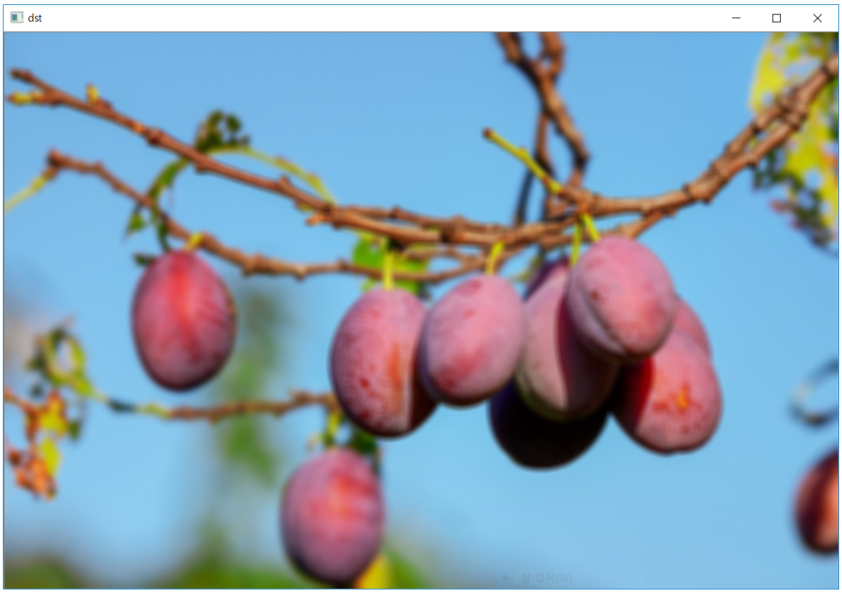
흐림 효과(Blur)
ː ː 실행 결과

Slide 29
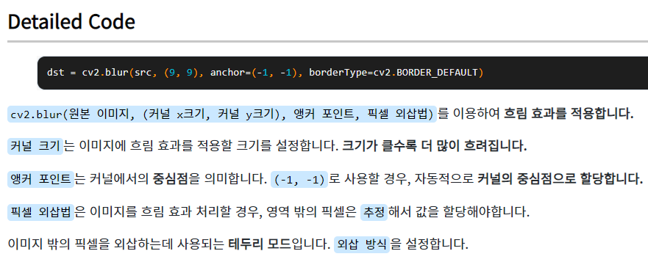
흐림 효과(Blur)
import cv2
src = cv2.imread("Image/geese.jpg", cv2.IMREAD_COLOR)
dst = cv2.blur(src, (9, 9), anchor=(-1, -1), borderType=cv2.BORDER_DEFAULT)
cv2.imshow("dst", dst)
cv2.waitKey(0)
cv2.destroyAllWindows()

Slide 30
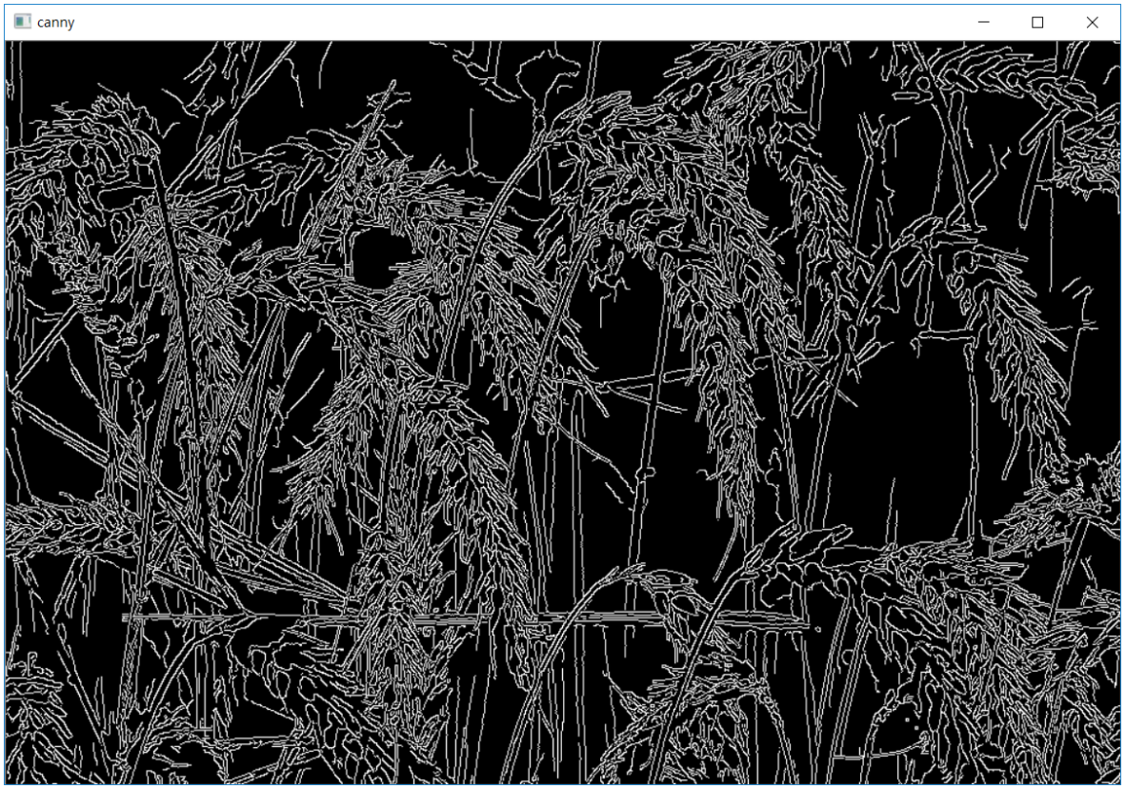
가장자리 검출(Edge)
ː ː 실행 결과

Slide 31
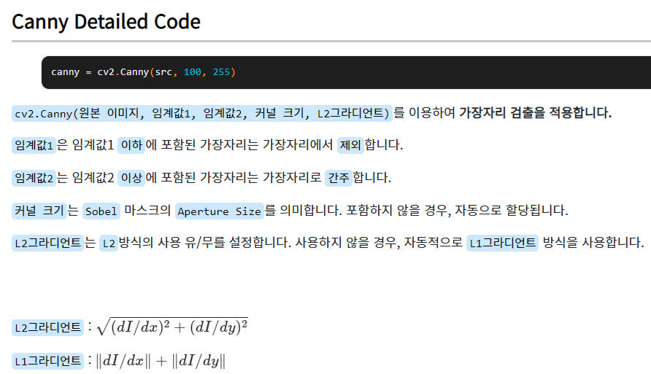
가장자리 검출(Edge)
import cv2
src = cv2.imread("Image/wheat.jpg", cv2.IMREAD_COLOR)
gray = cv2.cvtColor(src, cv2.COLOR_BGR2GRAY)
canny = cv2.Canny(src, 100, 255)
sobel = cv2.Sobel(gray, cv2.CV_8U, 1, 0, 3)
laplacian = cv2.Laplacian(gray, cv2.CV_8U, ksize=3)
cv2.imshow("canny", canny)
cv2.imshow("sobel", sobel)
cv2.imshow("laplacian", laplacian)
cv2.waitKey(0)
cv2.destroyAllWindows()

Slide 32
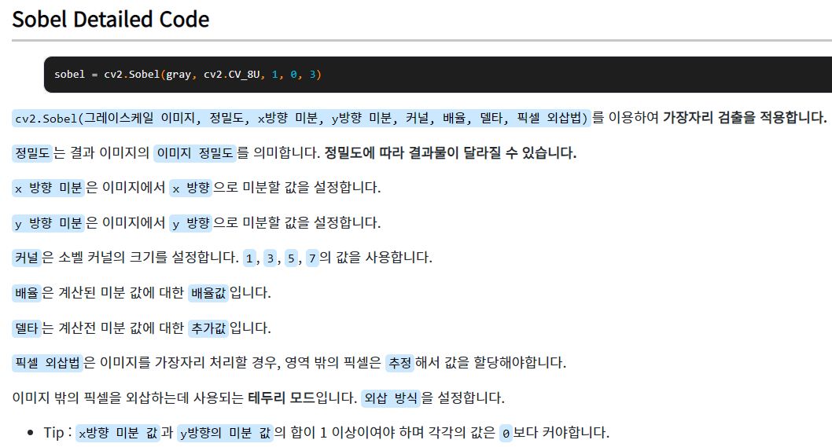
가장자리 검출(Edge)
import cv2
src = cv2.imread("Image/wheat.jpg", cv2.IMREAD_COLOR)
gray = cv2.cvtColor(src, cv2.COLOR_BGR2GRAY)
canny = cv2.Canny(src, 100, 255)
sobel = cv2.Sobel(gray, cv2.CV_8U, 1, 0, 3)
laplacian = cv2.Laplacian(gray, cv2.CV_8U, ksize=3)
cv2.imshow("canny", canny)
cv2.imshow("sobel", sobel)
cv2.imshow("laplacian", laplacian)
cv2.waitKey(0)
cv2.destroyAllWindows()

Slide 33
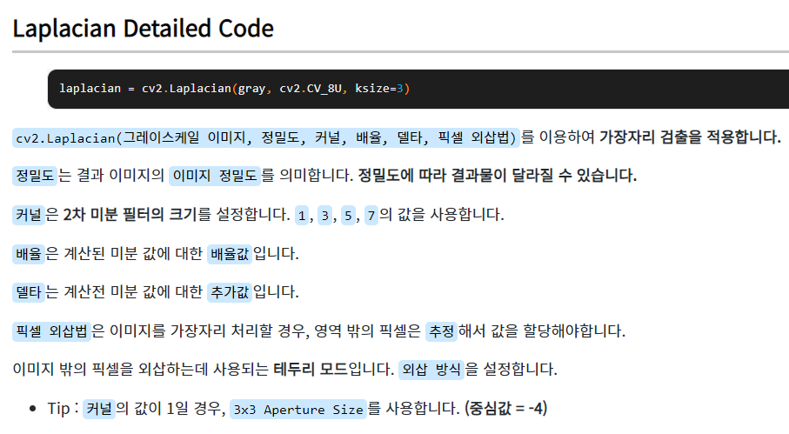
가장자리 검출(Edge)
import cv2
src = cv2.imread("Image/wheat.jpg", cv2.IMREAD_COLOR)
gray = cv2.cvtColor(src, cv2.COLOR_BGR2GRAY)
canny = cv2.Canny(src, 100, 255)
sobel = cv2.Sobel(gray, cv2.CV_8U, 1, 0, 3)
laplacian = cv2.Laplacian(gray, cv2.CV_8U, ksize=3)
cv2.imshow("canny", canny)
cv2.imshow("sobel", sobel)
cv2.imshow("laplacian", laplacian)
cv2.waitKey(0)
cv2.destroyAllWindows()

Slide 34
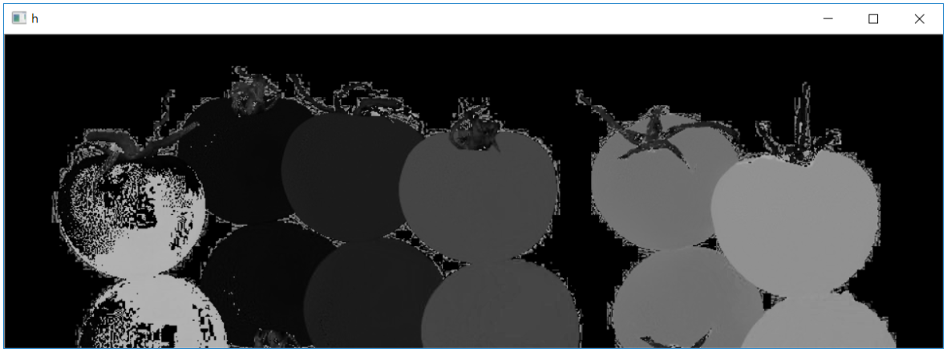
HSV(Hue, Saturation, Value)
ː ː 실행 결과

Slide 35
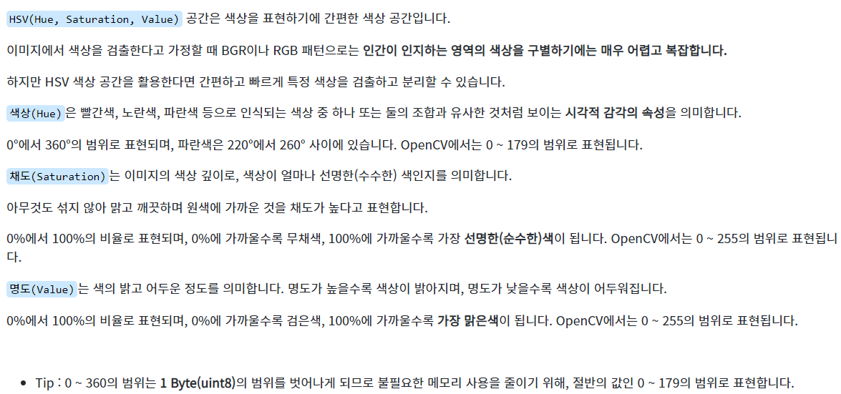
HSV(Hue, Saturation, Value)
import cv2
src = cv2.imread("Image/tomato.jpg", cv2.IMREAD_COLOR)
hsv = cv2.cvtColor(src, cv2.COLOR_BGR2HSV)
h, s, v = cv2.split(hsv)
cv2.imshow("h", h)
cv2.imshow("s", s)
cv2.imshow("v", v)
cv2.waitKey()
cv2.destroyAllWindows()

Slide 36
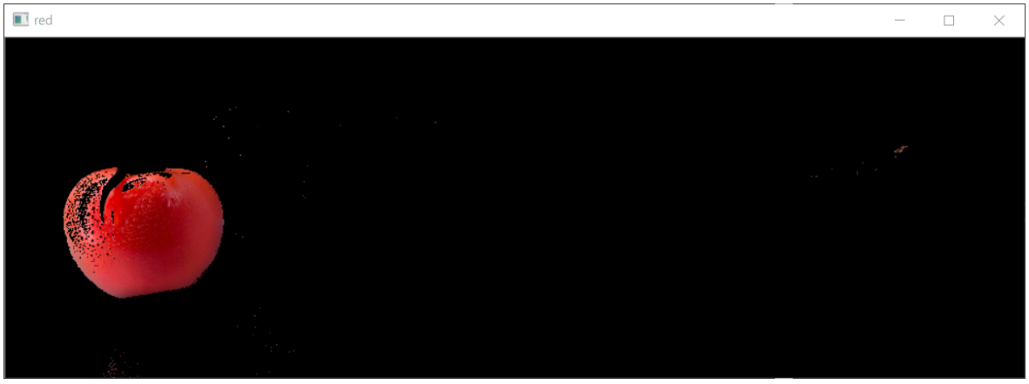
채널 범위 병합(addWeighted)
ː ː 실행 결과

Slide 37
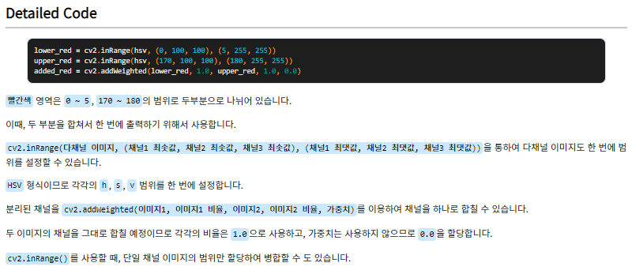
채널 범위 병합(addWeighted)
import cv2
src = cv2.imread("Image/tomato.jpg", cv2.IMREAD_COLOR)
hsv = cv2.cvtColor(src, cv2.COLOR_BGR2HSV)
h, s, v = cv2.split(hsv)
lower_red = cv2.inRange(hsv, (0, 100, 100), (5, 255, 255))
upper_red = cv2.inRange(hsv, (170, 100, 100), (180, 255, 255))
added_red = cv2.addWeighted(lower_red, 1.0, upper_red, 1.0, 0.0)
red = cv2.bitwise_and(hsv, hsv, mask = added_red)
red = cv2.cvtColor(red, cv2.COLOR_HSV2BGR)
cv2.imshow("red", red)
cv2.waitKey(0)
cv2.destroyAllWindows()

Slide 38
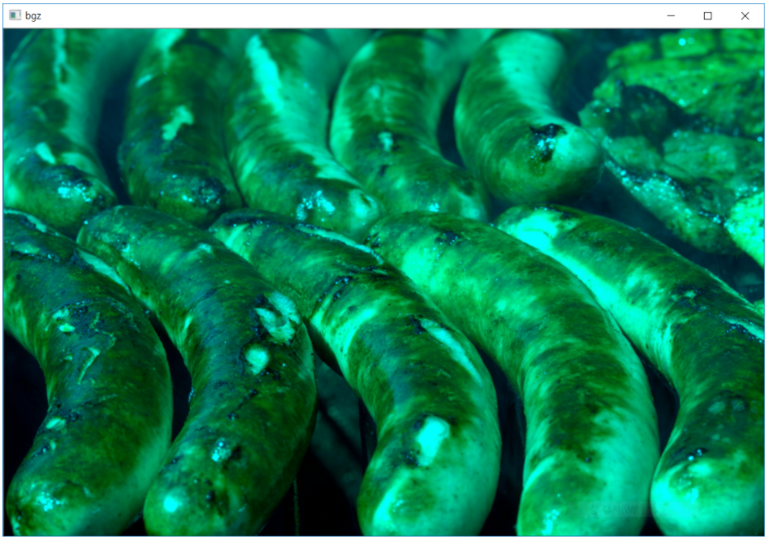
채널 분리(Split) 및 병합(Merge)
ː ː 실행 결과

Slide 39
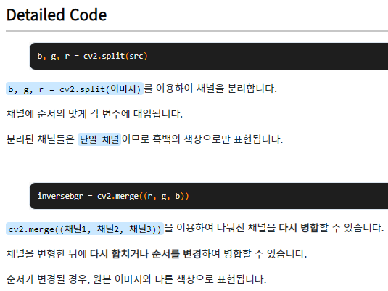
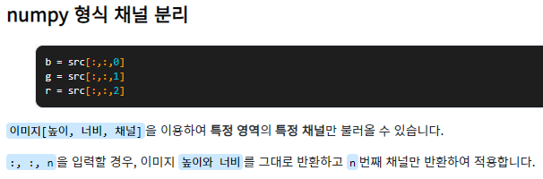
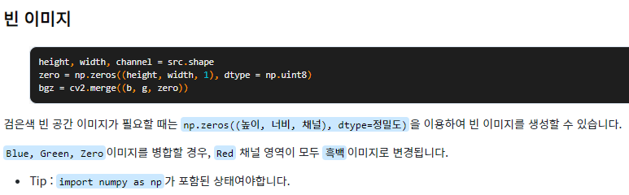
채널 분리(Split) 및 병합(Merge)
import cv2
src = cv2.imread("Image/tomato.jpg", cv2.IMREAD_COLOR)
b, g, r = cv2.split(src)
inversebgr = cv2.merge((r, g, b))
cv2.imshow("b", b)
cv2.imshow("g", g)
cv2.imshow("r", r)
cv2.imshow("inverse", inversebgr)
cv2.waitKey(0)
cv2.destroyAllWindows()

Slide 40
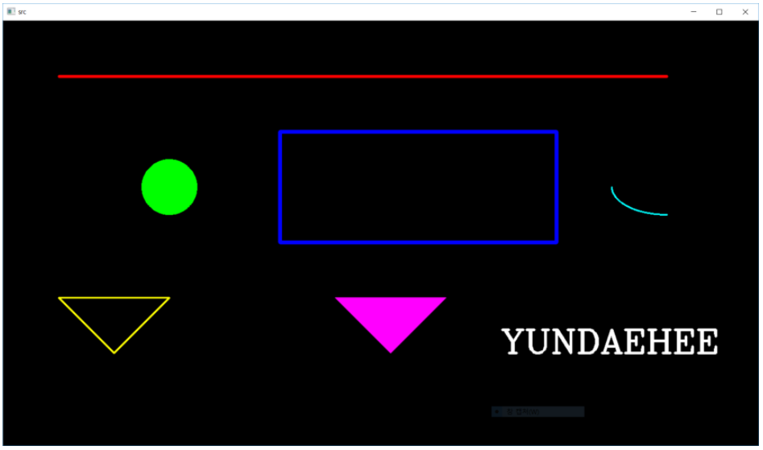
그래픽 드로잉(Drawing)
ː ː 실행 결과

Slide 41
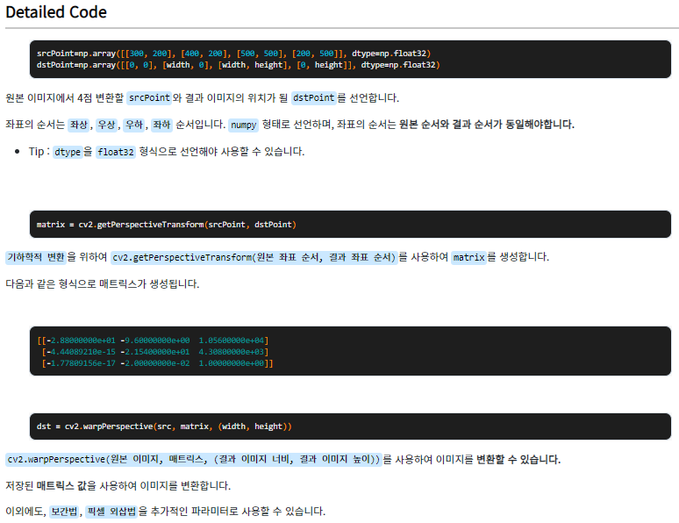
그래픽 드로잉(Drawing)
import numpy as np
import cv2
src = cv2.imread("Image/harvest.jpg", cv2.IMREAD_COLOR)
height, width, channel = src.shape
srcPoint=np.array([[300, 200], [400, 200], [500, 500], [200, 500]], dtype=np.float32)
dstPoint=np.array([[0, 0], [width, 0], [width, height], [0, height]], dtype=np.float32)
matrix = cv2.getPerspectiveTransform(srcPoint, dstPoint)
dst = cv2.warpPerspective(src, matrix, (width, height))
cv2.imshow("dst", dst)
cv2.waitKey(0)
cv2.destroyAllWindows()

Slide 42
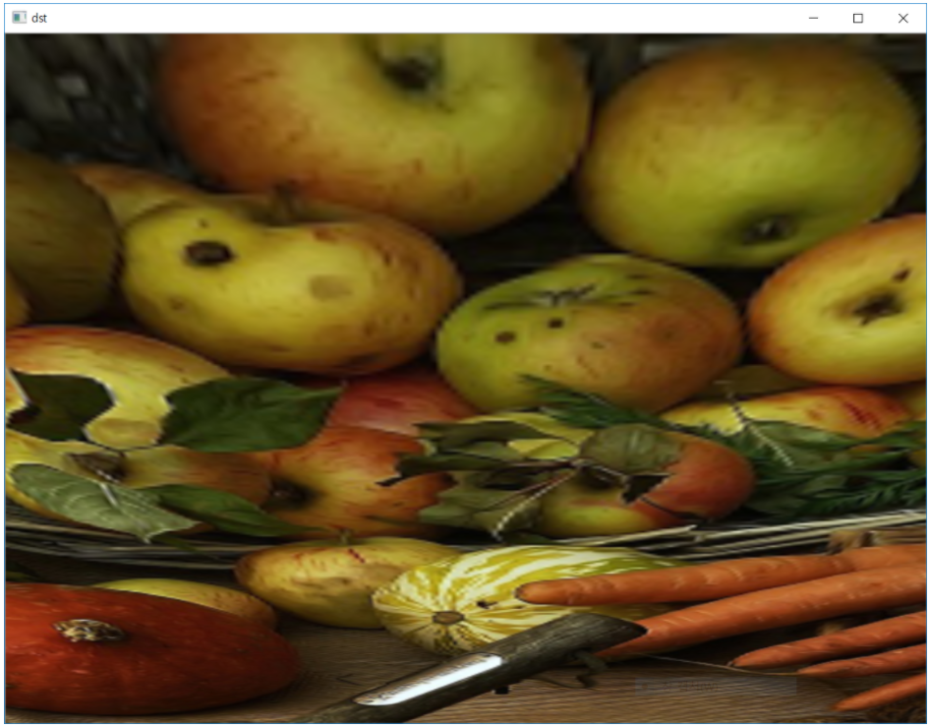
기하학적 변환(Warp Perspective)
ː ː 실행 결과

Slide 43
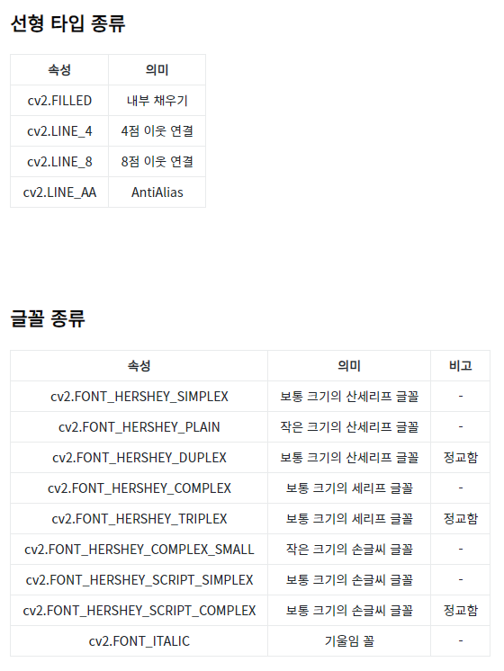
기하학적 변환(Warp Perspective)
import numpy as np
import cv2
src = np.zeros((768, 1366, 3), dtype = np.uint8)
cv2.line(src, (100, 100), (1200, 100), (0, 0, 255), 3, cv2.LINE_AA)
cv2.circle(src, (300, 300), 50, (0, 255, 0), cv2.FILLED, cv2.LINE_4)
cv2.rectangle(src, (500, 200), (1000, 400), (255, 0, 0), 5, cv2.LINE_8)
cv2.ellipse(src, (1200, 300), (100, 50), 0, 90, 180, (255, 255, 0), 2)
pts1 = np.array([[100, 500], [300, 500], [200, 600]])
pts2 = np.array([[600, 500], [800, 500], [700, 600]])
cv2.polylines(src, [pts1], True, (0, 255, 255), 2)
cv2.fillPoly(src, [pts2], (255, 0, 255), cv2.LINE_AA)
cv2.putText(src, "YUNDAEHEE", (900, 600), cv2.FONT_HERSHEY_COMPLEX, 2, (255, 255, 255), 3)
cv2.imshow("src", src)
cv2.waitKey(0)
cv2.destroyAllWindows()

Slide 44
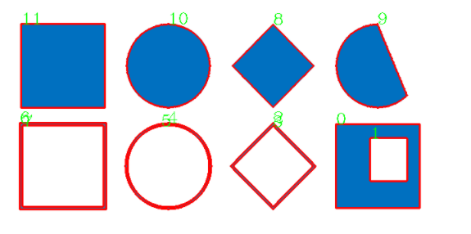
윤곽선(Contour)
ː ː 실행 결과

Slide 45
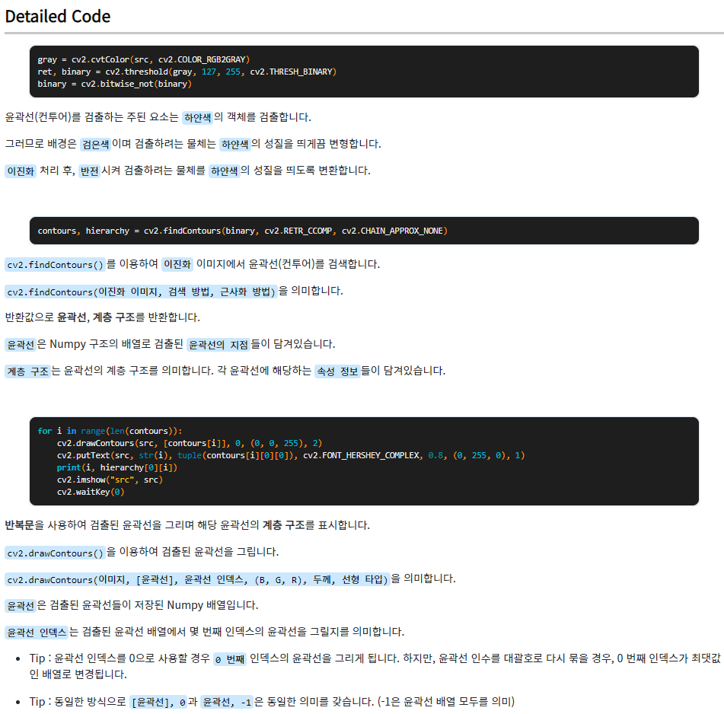
윤곽선(Contour)
import cv2
src = cv2.imread("Image/contours.png", cv2.IMREAD_COLOR)
gray = cv2.cvtColor(src, cv2.COLOR_RGB2GRAY)
ret, binary = cv2.threshold(gray, 127, 255, cv2.THRESH_BINARY)
binary = cv2.bitwise_not(binary)
contours, hierarchy = cv2.findContours(binary, cv2.RETR_CCOMP, cv2.CHAIN_APPROX_NONE)
for i in range(len(contours)):
cv2.drawContours(src, [contours[i]], 0, (0, 0, 255), 2)
cv2.putText(src, str(i), tuple(contours[i][0][0]), cv2.FONT_HERSHEY_COMPLEX, 0.8, (0, 255, 0), 1)
print(i, hierarchy[0][i])
cv2.imshow("src", src)
cv2.waitKey(0)
cv2.destroyAllWindows()

Slide 46
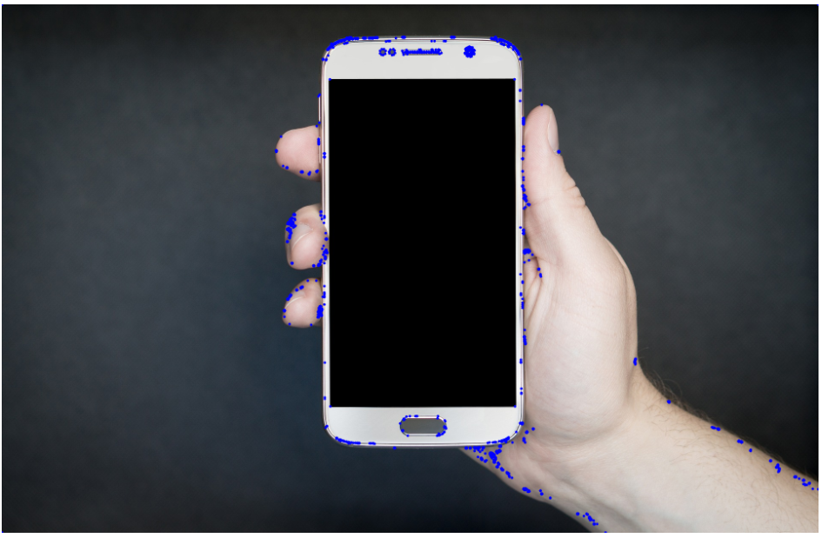
다각형 근사(Approx Poly)
ː ː 실행 결과

Slide 47


다각형 근사(Approx Poly)
import cv2
src = cv2.imread("Image/car.png", cv2.IMREAD_COLOR)
gray = cv2.cvtColor(src, cv2.COLOR_RGB2GRAY)
ret, binary = cv2.threshold(gray, 0, 255, cv2.THRESH_OTSU)
binary = cv2.bitwise_not(binary)
contours, hierarchy = cv2.findContours(binary, cv2.RETR_LIST, cv2.CHAIN_APPROX_TC89_KCOS)
for contour in contours:
epsilon = cv2.arcLength(contour, True) * 0.02
approx_poly = cv2.approxPolyDP(contour, epsilon, True)
for approx in approx_poly:
cv2.circle(src, tuple(approx[0]), 3, (255, 0, 0), -1)
cv2.imshow("src", src)
cv2.waitKey(0)
cv2.destroyAllWindows()

Slide 48

코너 검출(Good Features To Track)
ː ː 실행 결과

Slide 49

코너 검출(Good Features To Track)
import cv2
src = cv2.imread("Image/coffee.jpg")
dst = src.copy()
gray = cv2.cvtColor(src, cv2.COLOR_RGB2GRAY)
corners = cv2.goodFeaturesToTrack(gray, 100, 0.01, 5, blockSize=3, useHarrisDetector=True, k=0.03)
for i in corners:
cv2.circle(dst, tuple(i[0]), 3, (0, 0, 255), 2)
cv2.imshow("dst", dst)
cv2.waitKey(0)
cv2.destroyAllWindows()

Slide 50

블록 껍질(Convex Hull)
ː ː 실행 결과

Slide 51

블록 껍질(Convex Hull)
import cv2
src = cv2.imread("Image/convex.png")
dst = src.copy()
gray = cv2.cvtColor(src, cv2.COLOR_RGB2GRAY)
ret, binary = cv2.threshold(gray, 150, 255, cv2.THRESH_BINARY_INV)
contours, hierarchy = cv2.findContours(binary, cv2.RETR_CCOMP, cv2.CHAIN_APPROX_NONE)
for i in contours:
hull = cv2.convexHull(i, clockwise=True)
cv2.drawContours(dst, [hull], 0, (0, 0, 255), 2)
cv2.imshow("dst", dst)
cv2.waitKey(0)
cv2.destroyAllWindows()

Slide 52

모멘트(Moments)
ː ː 실행 결과

Slide 53


모멘트(Moments)
import cv2
src = cv2.imread("Image/convex.png")
dst = src.copy()
gray = cv2.cvtColor(src, cv2.COLOR_RGB2GRAY)
ret, binary = cv2.threshold(gray, 150, 255, cv2.THRESH_BINARY_INV)
contours, hierarchy = cv2.findContours(binary, cv2.RETR_CCOMP, cv2.CHAIN_APPROX_NONE)
for i in contours:
M = cv2.moments(i)
cX = int(M['m10'] / M['m00'])
cY = int(M['m01'] / M['m00'])
cv2.circle(dst, (cX, cY), 3, (255, 0, 0), -1)
cv2.drawContours(dst, [i], 0, (0, 0, 255), 2)
cv2.imshow("dst", dst)
cv2.waitKey(0)
cv2.destroyAllWindows()

Slide 54

모폴로지 변환(Morphological Transformation)
ː ː 실행 결과

Slide 55


모폴로지 변환(Morphological Transformation)
import numpy as np
import cv2
src = cv2.imread('zebra.jpg')
kernel = cv2.getStructuringElement(cv2.MORPH_CROSS, (9, 9))
dilate = cv2.dilate(src, kernel, anchor=(-1, -1), iterations=5)
erode = cv2.erode(src, kernel, anchor=(-1, -1), iterations=5)
dst = np.concatenate((src, dilate, erode), axis=1)
cv2.imshow('dst', dst)
cv2.waitKey(0)
cv2.destroyAllWindows()

Slide 56

모폴로지 연산(Morphological Calculate)
ː ː 실행 결과

Slide 57



모폴로지 연산(Morphological Calculate)
import numpy as np
import cv2
src = cv2.imread('office.jpg')
kernel = cv2.getStructuringElement(cv2.MORPH_CROSS, (9, 9))
dst = cv2.morphologyEx(src, cv2.MORPH_OPEN, kernel, iterations=9)
cv2.imshow('dst', dst)
cv2.waitKey(0)
cv2.destroyAllWindows()

Slide 58

직선 검출(Line Detection)
ː ː 실행 결과

Slide 59

직선 검출(Line Detection)
import numpy as np
import cv2
src = cv2.imread("road.jpg")
dst = src.copy()
gray = cv2.cvtColor(src, cv2.COLOR_BGR2GRAY)
canny = cv2.Canny(gray, 5000, 1500, apertureSize = 5, L2gradient = True)
lines = cv2.HoughLines(canny, 0.8, np.pi / 180, 150, srn = 100, stn = 200, min_theta = 0, max_theta = np.pi)
for i in lines:
rho, theta = i[0][0], i[0][1]
a, b = np.cos(theta), np.sin(theta)
x0, y0 = a*rho, b*rho
scale = src.shape[0] + src.shape[1]
x1 = int(x0 + scale * -b)
y1 = int(y0 + scale * a)
x2 = int(x0 - scale * -b)
y2 = int(y0 - scale * a)
cv2.line(dst, (x1, y1), (x2, y2), (0, 0, 255), 2)
cv2.circle(dst, (x0, y0), 3, (255, 0, 0), 5, cv2.FILLED)
cv2.imshow("dst", dst)
cv2.waitKey(0)
cv2.destroyAllWindows()

Slide 60

원 검출(Circle Detection)
ː ː 실행 결과

Slide 61

원 검출(Circle Detection)
import cv2
src = cv2.imread("colorball.jpg")
dst = src.copy()
gray = cv2.cvtColor(src, cv2.COLOR_BGR2GRAY)
circles = cv2.HoughCircles(gray, cv2.HOUGH_GRADIENT, 1, 100, param1 = 250, param2 = 10, minRadius = 80, maxRadius = 120)
for i in circles[0]:
cv2.circle(dst, (i[0], i[1]), i[2], (255, 255, 255), 5)
cv2.imshow("dst", dst)
cv2.waitKey(0)
cv2.destroyAllWindows()

Slide 62

이미지 연산(Image Calculation)
ː ː 실행 결과

Slide 63


이미지 연산(Image Calculation)
import numpy as np
import cv2
src = cv2.imread("pencils.jpg")
number1 = np.ones_like(src) * 127
number2 = np.ones_like(src) * 2
add = cv2.add(src, number1)
sub = cv2.subtract(src, number1)
mul = cv2.multiply(src, number2)
div = cv2.divide(src, number2)
src = np.concatenate((src, src, src, src), axis = 1)
number = np.concatenate((number1, number1, number2, number2), axis = 1)
dst = np.concatenate((add, sub, mul, div), axis = 1)
dst = np.concatenate((src, number, dst), axis = 0)
cv2.imshow("dst", dst)
cv2.waitKey(0)
cv2.destroyAllWindows()

Slide 64

이미지 연산(Image Calculation)
ː ː 실행 결과

Slide 65

이미지 연산(Image Calculation)
import numpy as np
import cv2
src = cv2.imread("pencils.jpg")
number = np.ones_like(src) * 127
_max = cv2.max(src, number)
_min = cv2.min(src, number)
_abs = cv2.absdiff(src, number)
compare = cv2.compare(src, number, cv2.CMP_GT)
src = np.concatenate((src, src, src, src), axis = 1)
number = np.concatenate((number, number, number, number), axis = 1)
dst = np.concatenate((_max, _min, _abs, compare), axis = 1)
dst = np.concatenate((src, number, dst), axis = 0)
cv2.imshow("dst", dst)
cv2.waitKey(0)
cv2.destroyAllWindows()

Slide 66

비트 연산(Bitwise)
ː ː 실행 결과

Slide 67

비트 연산(Bitwise)
import numpy as np
import cv2
src = cv2.imread("analysis.jpg")
gray = cv2.cvtColor(src, cv2.COLOR_BGR2GRAY)
_, binary = cv2.threshold(gray, 127, 255, cv2.THRESH_BINARY)
_and = cv2.bitwise_and(gray, binary)
_or = cv2.bitwise_or(gray, binary)
_xor = cv2.bitwise_xor(gray, binary)
_not = cv2.bitwise_not(gray)
src = np.concatenate((np.zeros_like(gray), gray, binary, np.zeros_like(gray)), axis = 1)
dst = np.concatenate((_and, _or, _xor, _not), axis = 1)
dst = np.concatenate((src, dst), axis = 0)
cv2.imshow("dst", dst)
cv2.waitKey(0)
cv2.destroyAllWindows()

Slide 68

히스토그램(Histogram)
ː ː 실행 결과

Slide 69

히스토그램(Histogram)
import cv2
import numpy as np
src = cv2.imread("road.jpg")
gray = cv2.cvtColor(src, cv2.COLOR_BGR2GRAY)
result = np.zeros((src.shape[0], 256), dtype=np.uint8)
hist = cv2.calcHist([gray], [0], None, [256], [0, 256])
cv2.normalize(hist, hist, 0, result.shape[0], cv2.NORM_MINMAX)
for x, y in enumerate(hist):
cv2.line(result, (x, result.shape[0]), (x, result.shape[0] - y), 255)
dst = np.hstack([gray, result])
cv2.imshow("dst", dst)
cv2.waitKey(0)
cv2.destroyAllWindows()

Slide 70

픽셀 접근(Pixel Access)
ː ː 실행 결과

Slide 71

픽셀 접근(Pixel Access)
import cv2
import numpy as np
gray = np.linspace(0, 255, num=90000, endpoint=True, retstep=False, dtype=np.uint8).reshape(300, 300, 1)
color = np.zeros((300, 300, 3), np.uint8)
color[0:150, :, 0] = gray[0:150, :, 0]
color[:, 150:300, 2] = gray[:, 150:300, 0]
x, y, c = 200, 100, 0
access_gray = gray[y, x, c]
access_color_blue = color[y, x, c]
access_color = color[y, x]
print(access_gray)
print(access_color_blue)
print(access_color)
cv2.imshow("gray", gray)
cv2.imshow("color", color)
cv2.waitKey(0)
cv2.destroyAllWindows()

Slide 72

트랙 바(Track Bar)
ː ː 실행 결과

Slide 73

트랙 바(Track Bar)
import cv2
def onChange(pos):
pass
src = cv2.imread("cherryblossom.jpg", cv2.IMREAD_GRAYSCALE)
cv2.namedWindow("Trackbar Windows")
cv2.createTrackbar("threshold", "Trackbar Windows", 0, 255, onChange)
cv2.createTrackbar("maxValue", "Trackbar Windows", 0, 255, lambda x : x)
cv2.setTrackbarPos("threshold", "Trackbar Windows", 127)
cv2.setTrackbarPos("maxValue", "Trackbar Windows", 255)
while cv2.waitKey(1) != ord('q'):
thresh = cv2.getTrackbarPos("threshold", "Trackbar Windows")
maxval = cv2.getTrackbarPos("maxValue", "Trackbar Windows")
_, binary = cv2.threshold(src, thresh, maxval, cv2.THRESH_BINARY)
cv2.imshow("Trackbar Windows", binary)
cv2.destroyAllWindows()

Slide 74

트랙 바(Track Bar)
import cv2
def onChange(pos):
pass
src = cv2.imread("cherryblossom.jpg", cv2.IMREAD_GRAYSCALE)
cv2.namedWindow("Trackbar Windows")
cv2.createTrackbar("threshold", "Trackbar Windows", 0, 255, onChange)
cv2.createTrackbar("maxValue", "Trackbar Windows", 0, 255, lambda x : x)
cv2.setTrackbarPos("threshold", "Trackbar Windows", 127)
cv2.setTrackbarPos("maxValue", "Trackbar Windows", 255)
while cv2.waitKey(1) != ord('q'):
thresh = cv2.getTrackbarPos("threshold", "Trackbar Windows")
maxval = cv2.getTrackbarPos("maxValue", "Trackbar Windows")
_, binary = cv2.threshold(src, thresh, maxval, cv2.THRESH_BINARY)
cv2.imshow("Trackbar Windows", binary)
cv2.destroyAllWindows()

Slide 75


적응형 이진화(Adaptive Threshold)
ː ː 원본 이미지
ː ː 실행 결과

Slide 76

적응형 이진화(Adaptive Threshold)
import cv2
src = cv2.imread("tree.jpg")
gray = cv2.cvtColor(src, cv2.COLOR_BGR2GRAY)
binary = cv2.adaptiveThreshold(gray, 255, cv2.ADAPTIVE_THRESH_MEAN_C, cv2.THRESH_BINARY, 467, 37)
cv2.imshow("binary", binary)
cv2.waitKey(0)
cv2.destroyAllWindows()

Slide 77


템플릿 매칭(Template Matching)
ː ː 원본 이미지
ː ː 실행 결과

Slide 78

템플릿 매칭(Template Matching)
import cv2
src = cv2.imread("hats.png", cv2.IMREAD_GRAYSCALE)
templit = cv2.imread("hat.png", cv2.IMREAD_GRAYSCALE)
dst = cv2.imread("hats.png")
result = cv2.matchTemplate(src, templit, cv2.TM_SQDIFF_NORMED)
minVal, maxVal, minLoc, maxLoc = cv2.minMaxLoc(result)
x, y = minLoc
h, w = templit.shape
dst = cv2.rectangle(dst, (x, y), (x + w, y + h) , (0, 0, 255), 1)
cv2.imshow("dst", dst)
cv2.waitKey(0)
cv2.destroyAllWindows()

Slide 79

템플릿 매칭(Template Matching)
import cv2
src = cv2.imread("hats.png", cv2.IMREAD_GRAYSCALE)
templit = cv2.imread("hat.png", cv2.IMREAD_GRAYSCALE)
dst = cv2.imread("hats.png")
result = cv2.matchTemplate(src, templit, cv2.TM_SQDIFF_NORMED)
minVal, maxVal, minLoc, maxLoc = cv2.minMaxLoc(result)
x, y = minLoc
h, w = templit.shape
dst = cv2.rectangle(dst, (x, y), (x + w, y + h) , (0, 0, 255), 1)
cv2.imshow("dst", dst)
cv2.waitKey(0)
cv2.destroyAllWindows()

Slide 80

템플릿 매칭(Template Matching)
import cv2
src = cv2.imread("hats.png", cv2.IMREAD_GRAYSCALE)
templit = cv2.imread("hat.png", cv2.IMREAD_GRAYSCALE)
dst = cv2.imread("hats.png")
result = cv2.matchTemplate(src, templit, cv2.TM_SQDIFF_NORMED)
minVal, maxVal, minLoc, maxLoc = cv2.minMaxLoc(result)
x, y = minLoc
h, w = templit.shape
dst = cv2.rectangle(dst, (x, y), (x + w, y + h) , (0, 0, 255), 1)
cv2.imshow("dst", dst)
cv2.waitKey(0)
cv2.destroyAllWindows()

Slide 81


리매핑(Remapping)
ː ː 원본 이미지
ː ː 실행 결과

Slide 82

리매핑(Remapping)
import cv2
import numpy as np
src = cv2.imread("buildings.jpg")
height, width = src.shape[:2]
map2, map1 = np.indices((height, width), dtype=np.float32)
map1 = map1 + width / 100 * np.sin(map1)
map2 = map2 + height / 100 * np.cos(map2)
dst = cv2.remap(src, map1, map2, cv2.INTER_CUBIC)
cv2.imshow("dst", dst)
cv2.waitKey()

